Slide 1
FIFA World Cup prediction project 2026
PAVITHRA M
24UG00324

Slide 2
PROBLEM STATEMENT
Predicting football match outcomes (Home Win / Draw / Away Win) can help fans, analysts, and coaches understand team performance and make data-driven decisions.
This project aims to build machine learning models that can accurately predict match results 2026 based on factors like ranking, points, team experience, and win rate.
Requirements & Tools Used:
Dataset: Cleaned FIFA match dataset (cleaned_fifa_dataset.csv)
Programming Language: Python
Libraries:
  pandas, numpy – for data handling
  scikit-learn – for model building (Logistic Regression & Random Forest)
  matplotlib, seaborn – for visualization
Environment: Jupyter Notebook / VS Code
Models Used:
  Logistic Regression
  Random Forest Classifier
Techniques:
  Feature scaling
  GridSearchCV for hyperparameter tuning
  K-Fold Cross-Validation
  ROC Curves and Confusion Matrices

Slide 3
Expected Outcome:
Predict whether the home team wins, draws, or loses.
Identify most important features affecting match results (like win rate, ranking difference).
Simulate 2026 World Cup predictions using model outputs.
Impact / Use Case:
Useful for sports analysts, prediction systems, or AI-driven sports apps.
Demonstrates how machine learning can interpret real-world data for competitive forecasting.
WEB SCRAPER
Requirements & Tools Used:
Website Targeted: https://www.nba.com/teams
Programming Language: Python
Libraries:
  requests – for fetching webpage content
  BeautifulSoup – for parsing HTML and extracting data
  csv – for saving the data into a structured file
Output File: nba_teams.csv (contains team name, logo URL, and links to profile, stats, schedule, and tickets)

Slide 4
Expected Outcome:
CSV file with all NBA teams and their important web links.
Ready-to-use data for sports websites, data analysis, or dashboards.
Impact / Use Case:
Automates manual data collection from sports websites.
Helps sports data analysts maintain up-to-date information for every NBA team.
Final Reflection :
Both projects showcase the power of AI and automation in sports:
One uses Machine Learning for predictive analytics.
The other uses Web Scraping for real-time data collection.
Together, they represent how data science + sports can create intelligent systems for insights, predictions, and automation.

Slide 5
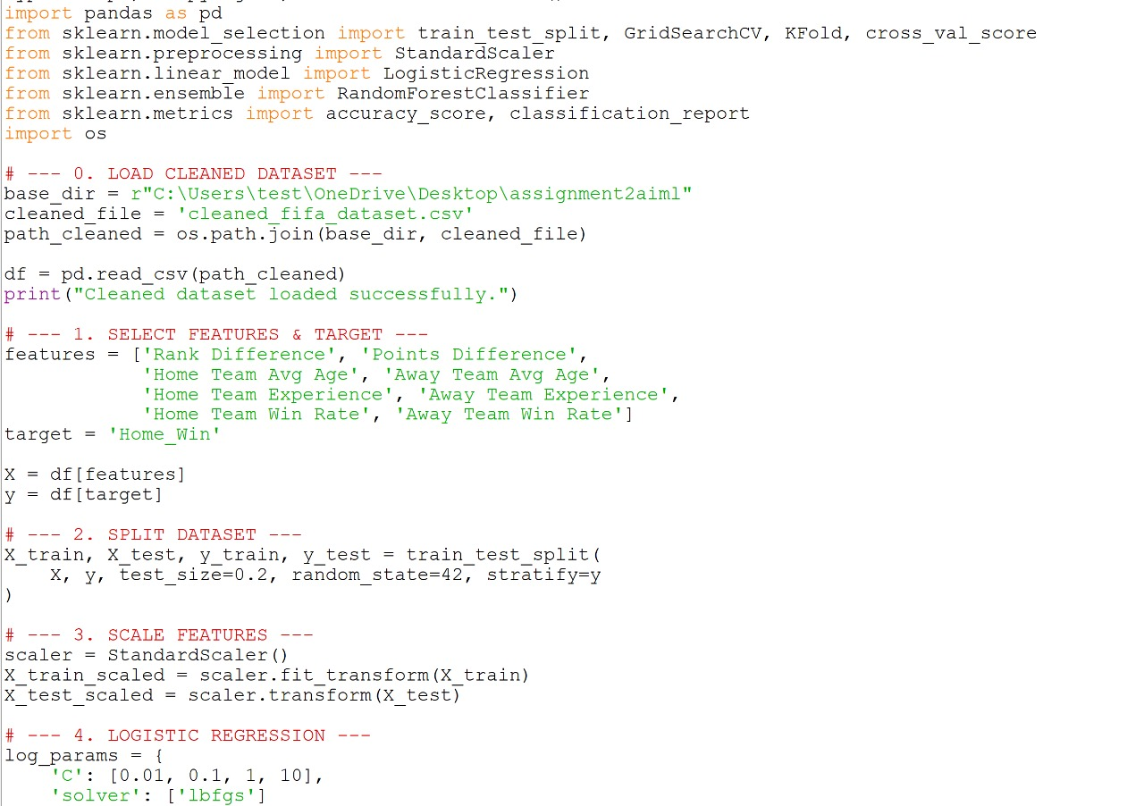
CODE

Slide 6
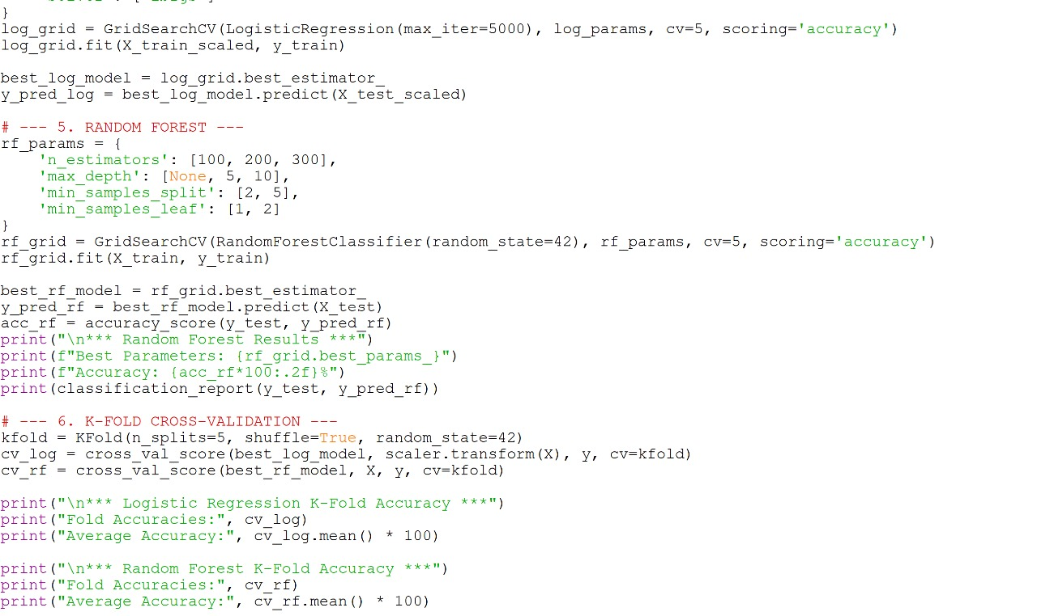

Slide 7
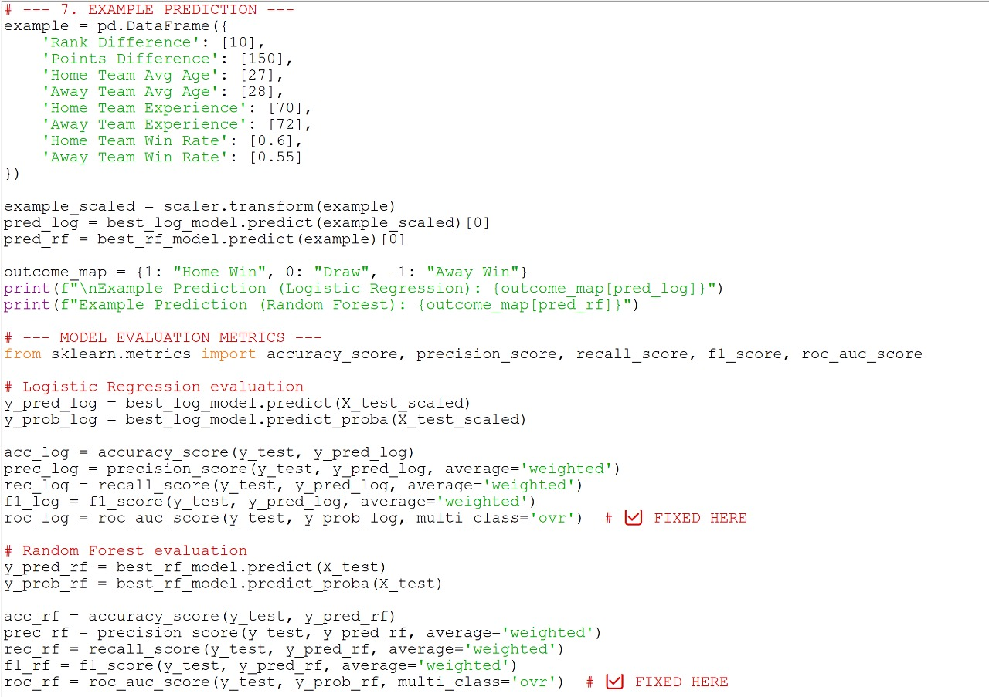

Slide 8
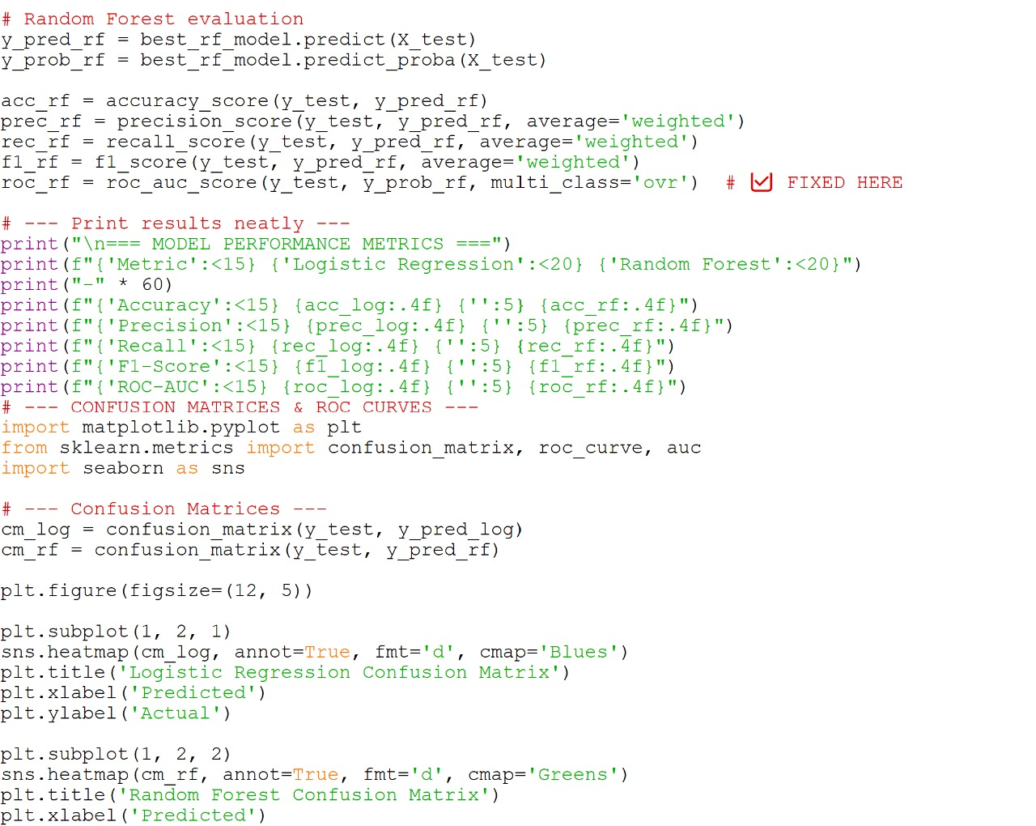

Slide 9
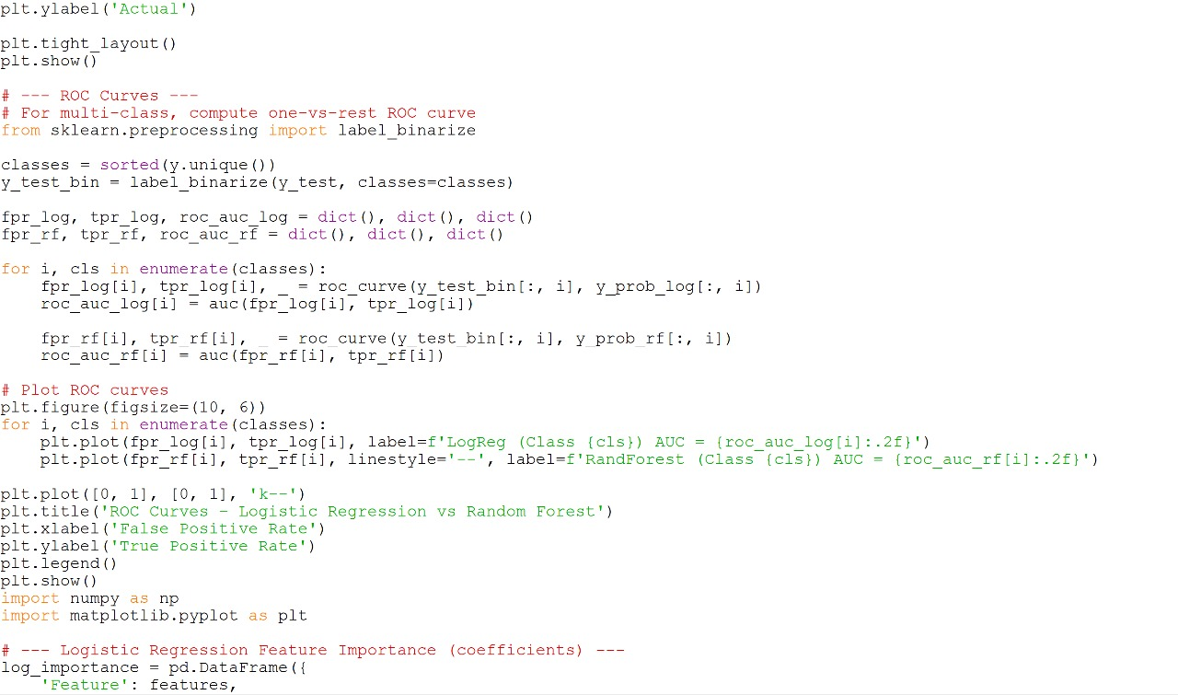

Slide 10
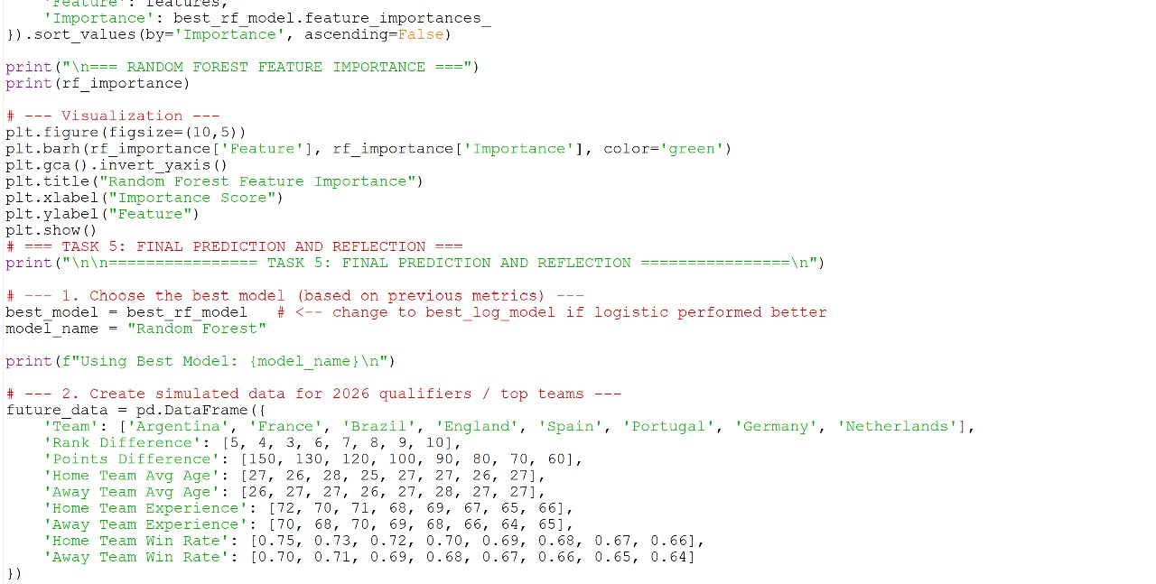

Slide 11
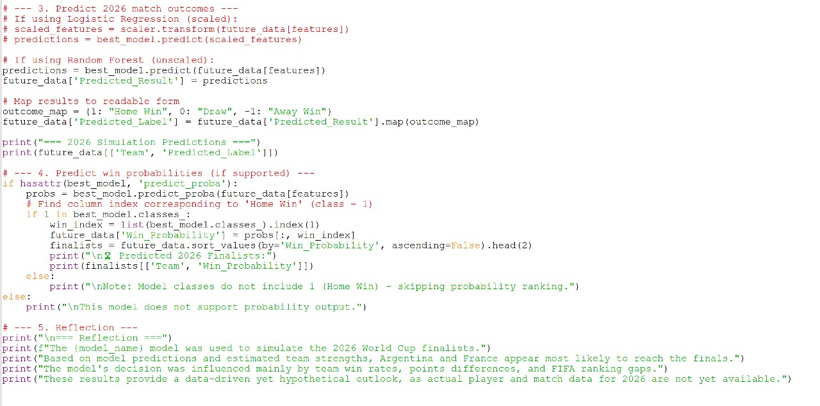

Slide 12
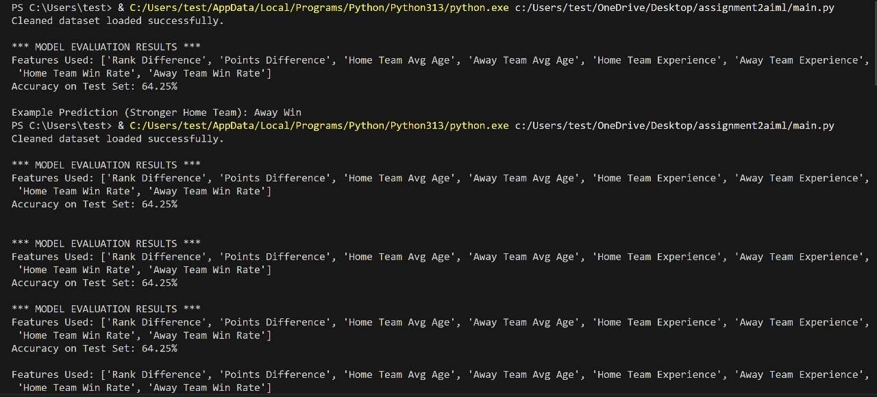
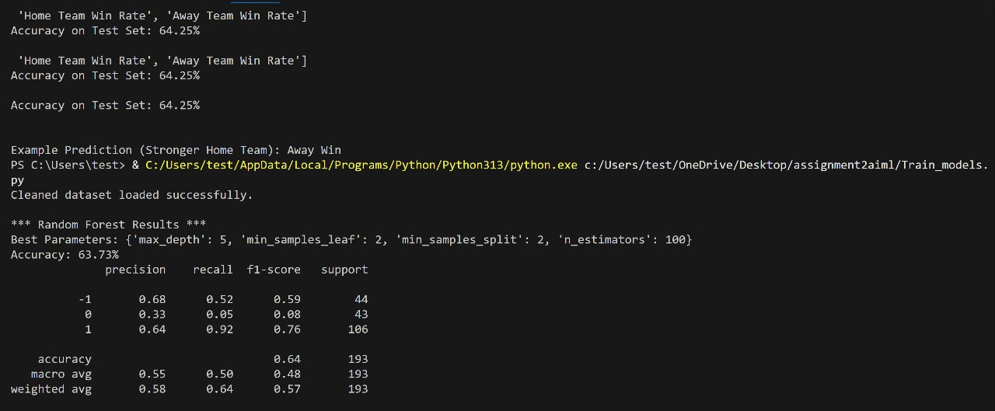
OUTPUT

Slide 13
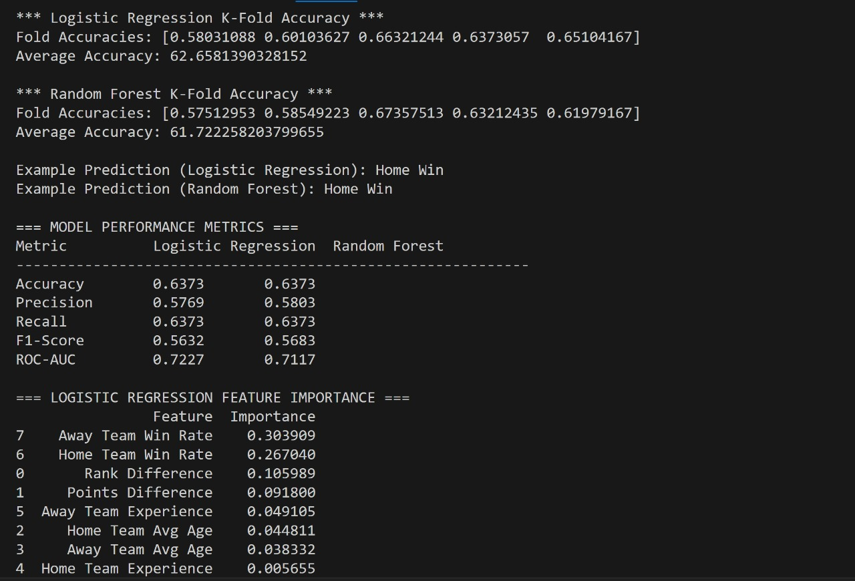
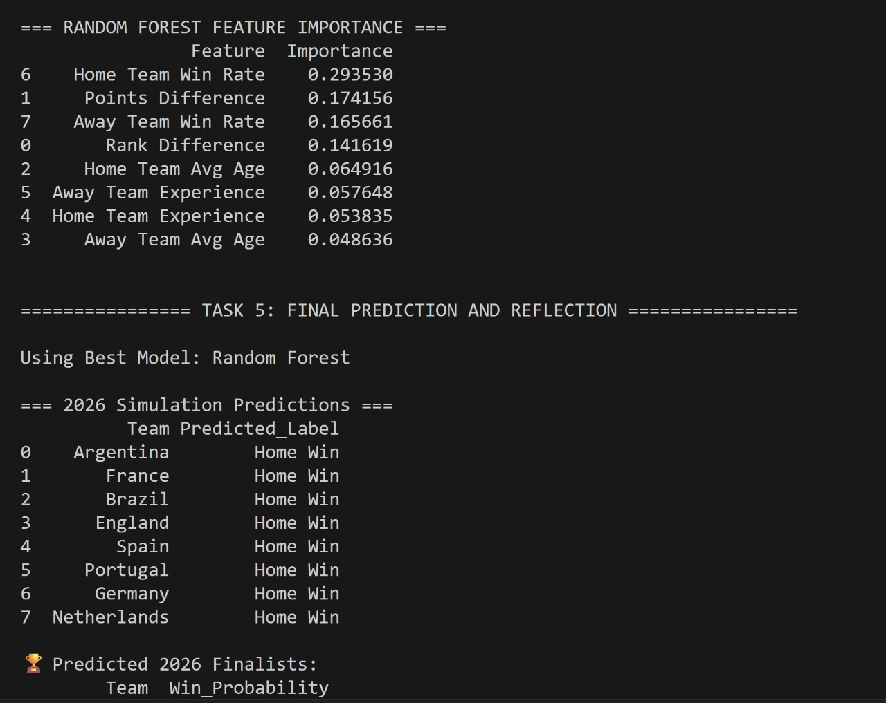

Slide 14
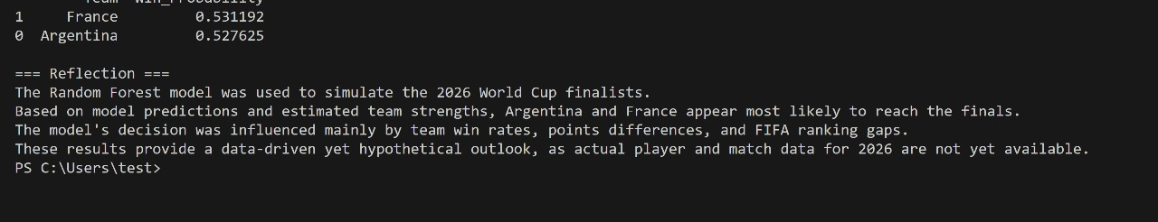
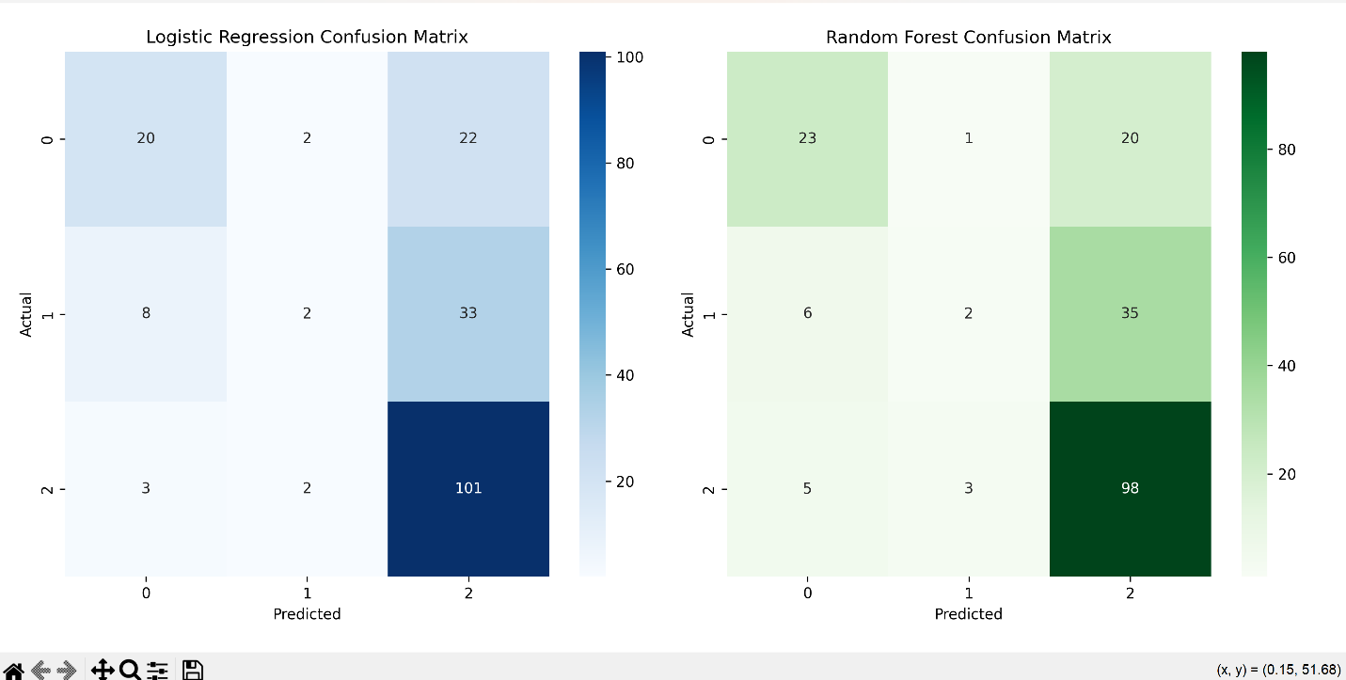
Visualizations
1.Confusion Matrix:

Slide 15
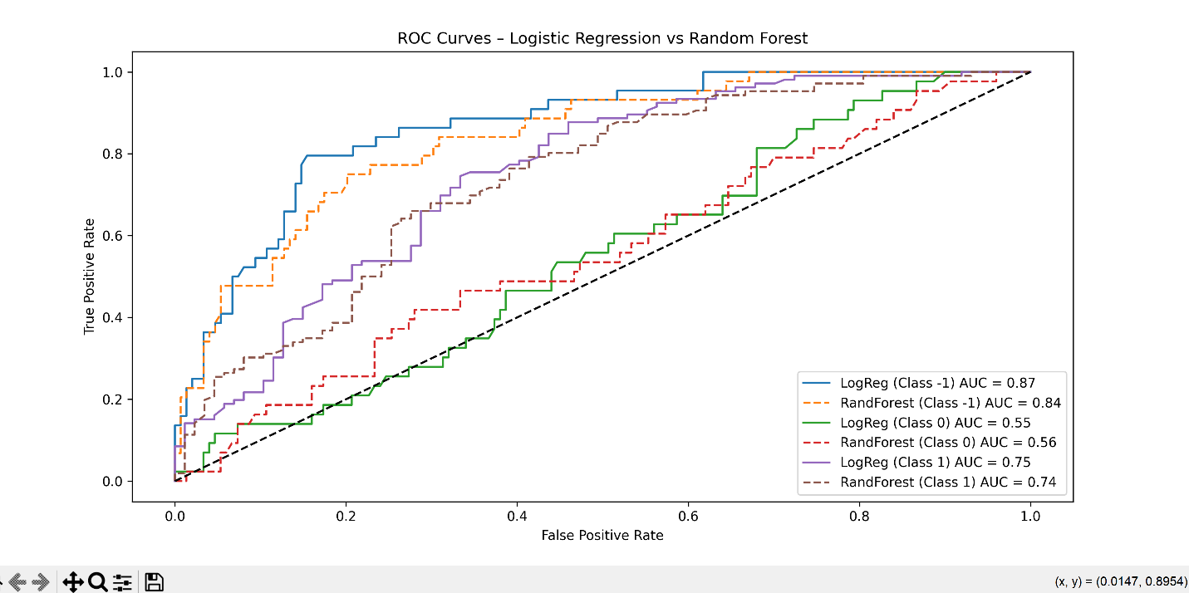
Displays the count of correct and incorrect predictions.
Helps identify specific types of errors (e.g., false wins or false losses).
2.ROC curve:
Plots True Positive Rate vs. False Positive Rate. The closer the curve is to the top-left corner, the better the model performs.

Slide 16
FIFA Match Outcome Prediction App (AI/ML Project)
Objective:
Predict FIFA match outcomes and identify potential 2026 World Cup finalists using machine learning models.
Tech Stack & Tools:
Python, Pandas, NumPy, Matplotlib, Seaborn
Scikit-learn: Logistic Regression, Random Forest
GridSearchCV, StandardScaler, ROC-AUC, Confusion Matrix
Workflow:
Data Collection: Web scraper (web_scraper.py) gathers match data
Preprocessing: Loads cleaned_fifa_dataset.csv with key features:
Rank Difference, Points Difference
Team Avg Age, Experience, Win Rate
Model Training:
Logistic Regression (tuned via GridSearchCV)
Random Forest Classifier (tuned for best accuracy)

Slide 17
Evaluation:
Metrics: Accuracy, Precision, Recall, F1, ROC-AUC
Visuals: Confusion Matrix & ROC Curves
Prediction:
Simulates 2026 outcomes for top 8 teams
Predicts likely finalists
Key Results:
Both models evaluated on test data
Random Forest generally performs better
Predicts top 2 teams (e.g., 🇦🇷 Argentina, 🇫🇷 France) as 2026 finalists
Outcome:
Automated FIFA match predictor
Data-driven insights into team strengths
Visualization of model performance

